Slide 1

Great Outdoors Return Reduction Project

Slide 2
Team 1
Charu Arora
Aman Raj
Aniket Samaddar
Rintu Mazumdar
Anshu Kumar
Azhar Hussain
Team 2
Shalu Panwar
Kunal Roychoudhury
Ayushi Dixit
Agnibha Chandra
Vikas Singh
Sujit Kumar

Slide 3
Great Outdoors
Electronic Distributor of Outdoor Products.
Sources it’s products from various manufacturers.
Supplies it to Retailers across countries.

Slide 4



Business-to-Business(B2B) Model
M
C
Online
M
C
Sales Representative
Retailer
M
C
Offline

Slide 5
Product Categories
Camping Equipment
Golf Equipment
Mountaineering Equipment
Outdoor Protection
Personal Accessories

Slide 6
Contribution to Topline

Slide 7
Contribution to Bottom-line

Slide 8
Business-to-Business(B2B) Model
M
C
Online
M
C
Sales Representative
Retailer
M
C
Offline

Slide 9
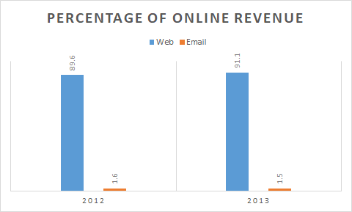

Slide 10
Team 1

Slide 11
FUNCTIONAL REQUIREMENTS
Order Management
Change Revenue Mix
Return Management
Retail Store Inventory

Slide 14
Contribution to Topline

Slide 16

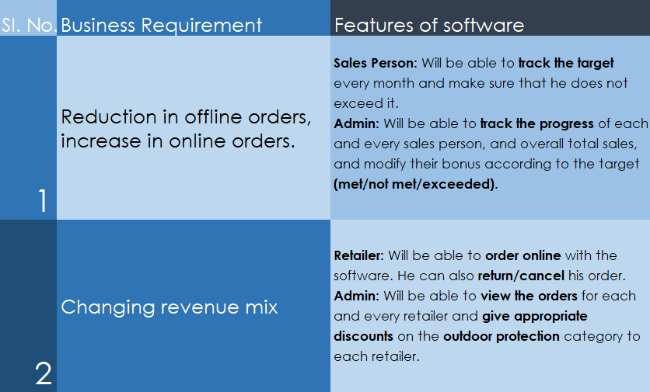

Slide 17
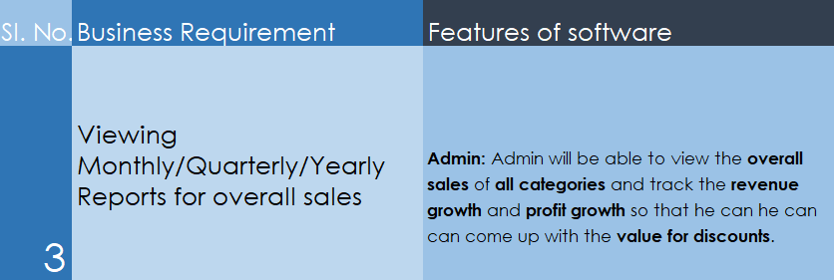

Slide 18
Use Case Diagram

Slide 19
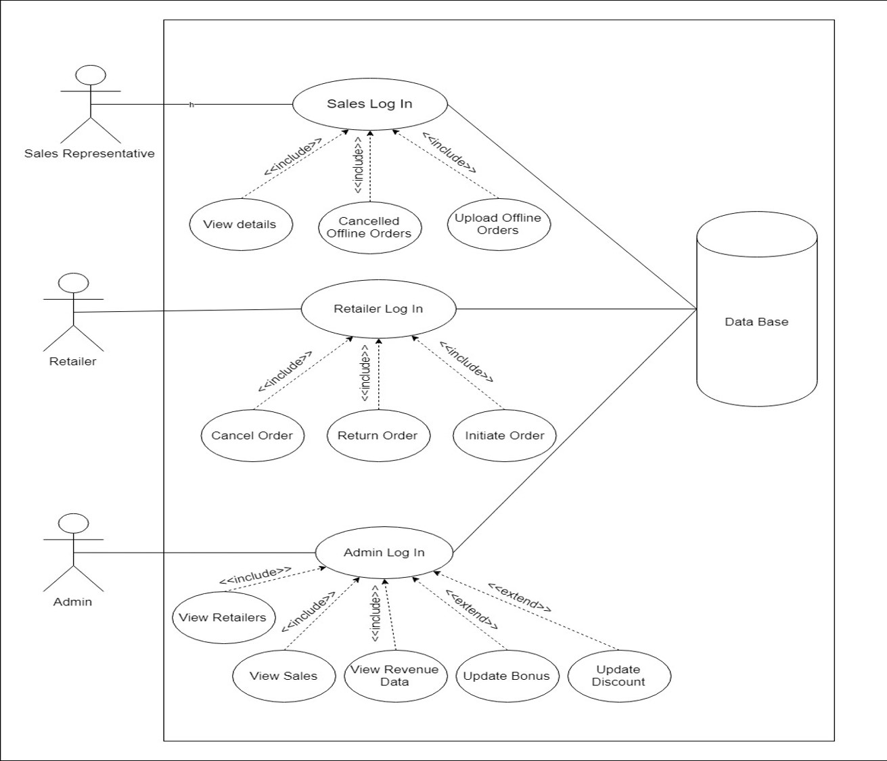

Slide 20
Class Diagram

Slide 21
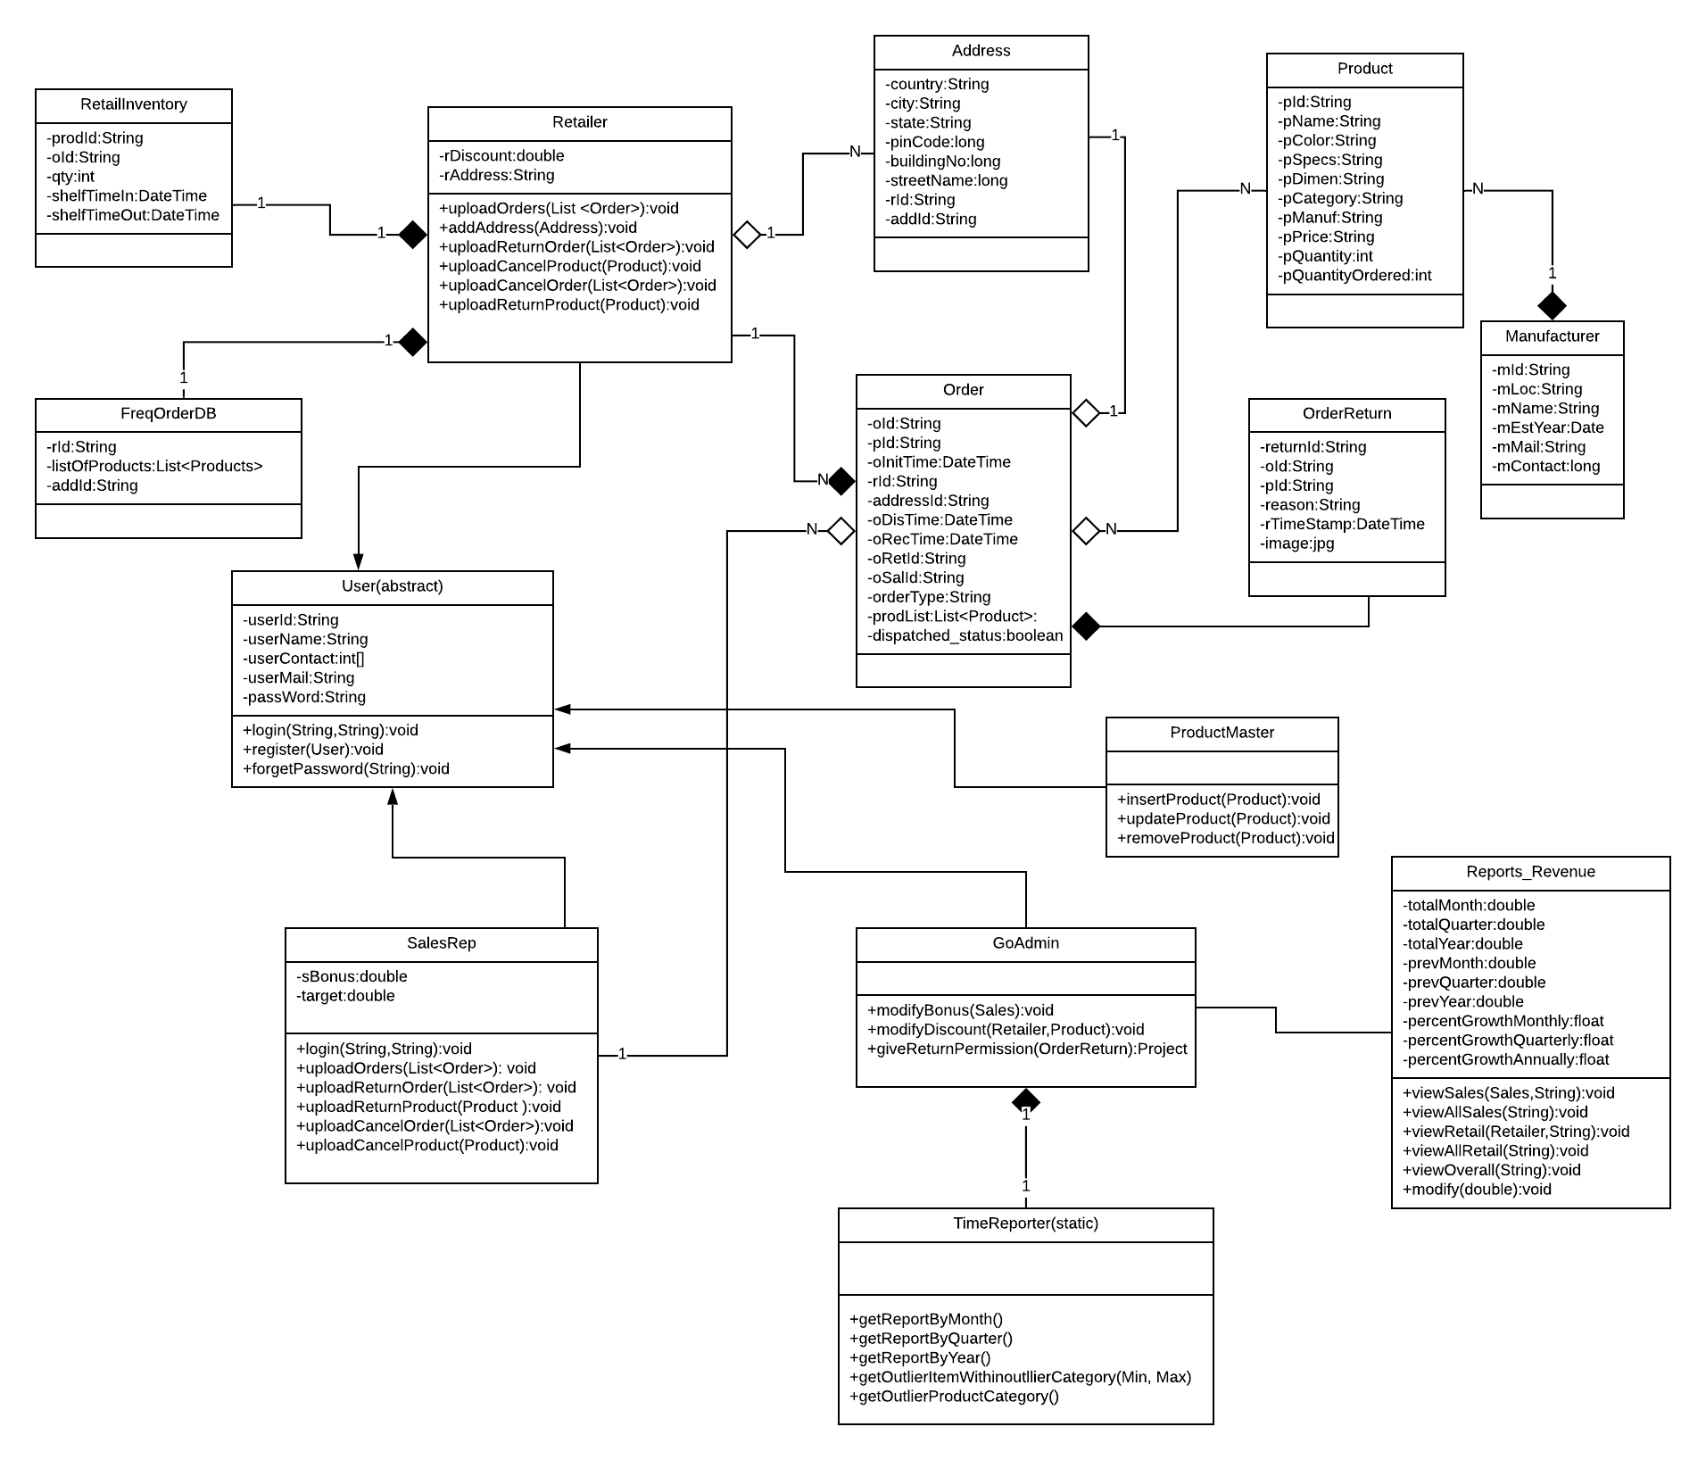

Slide 22
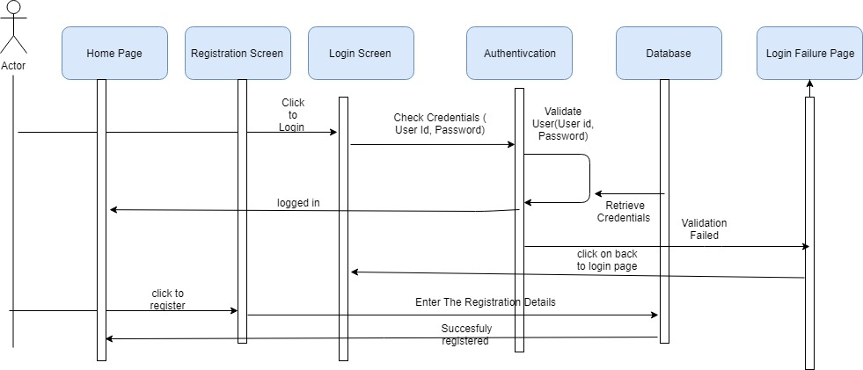
Sequence Diagram For User Login

Slide 23
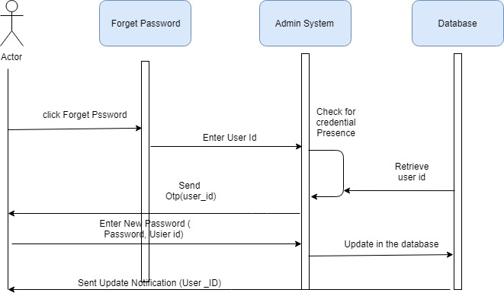
Sequence Diagram for Forgot Password

Slide 24
Sequence Diagram Of Retailer and Sales Representative

Slide 25
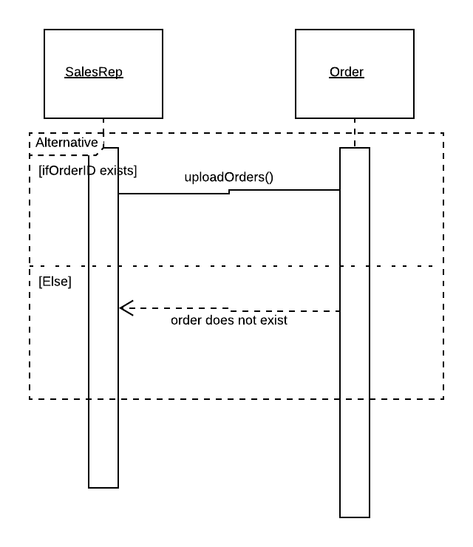
Sequence diagrams for uploading offline orders by sales

Slide 26
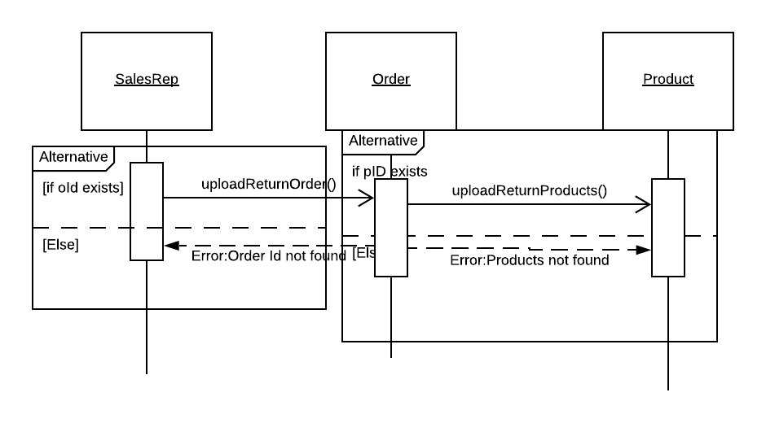
Sequence diagram for uploading Return Orders

Slide 27
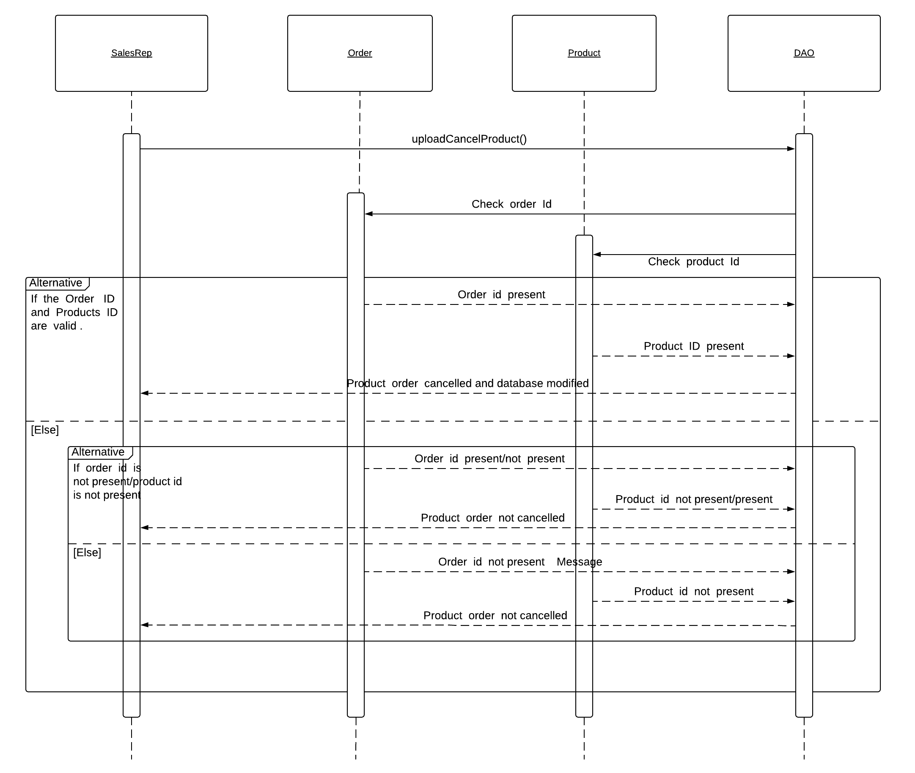
Sequence diagram
for uploading
Cancelled Product​

Slide 28
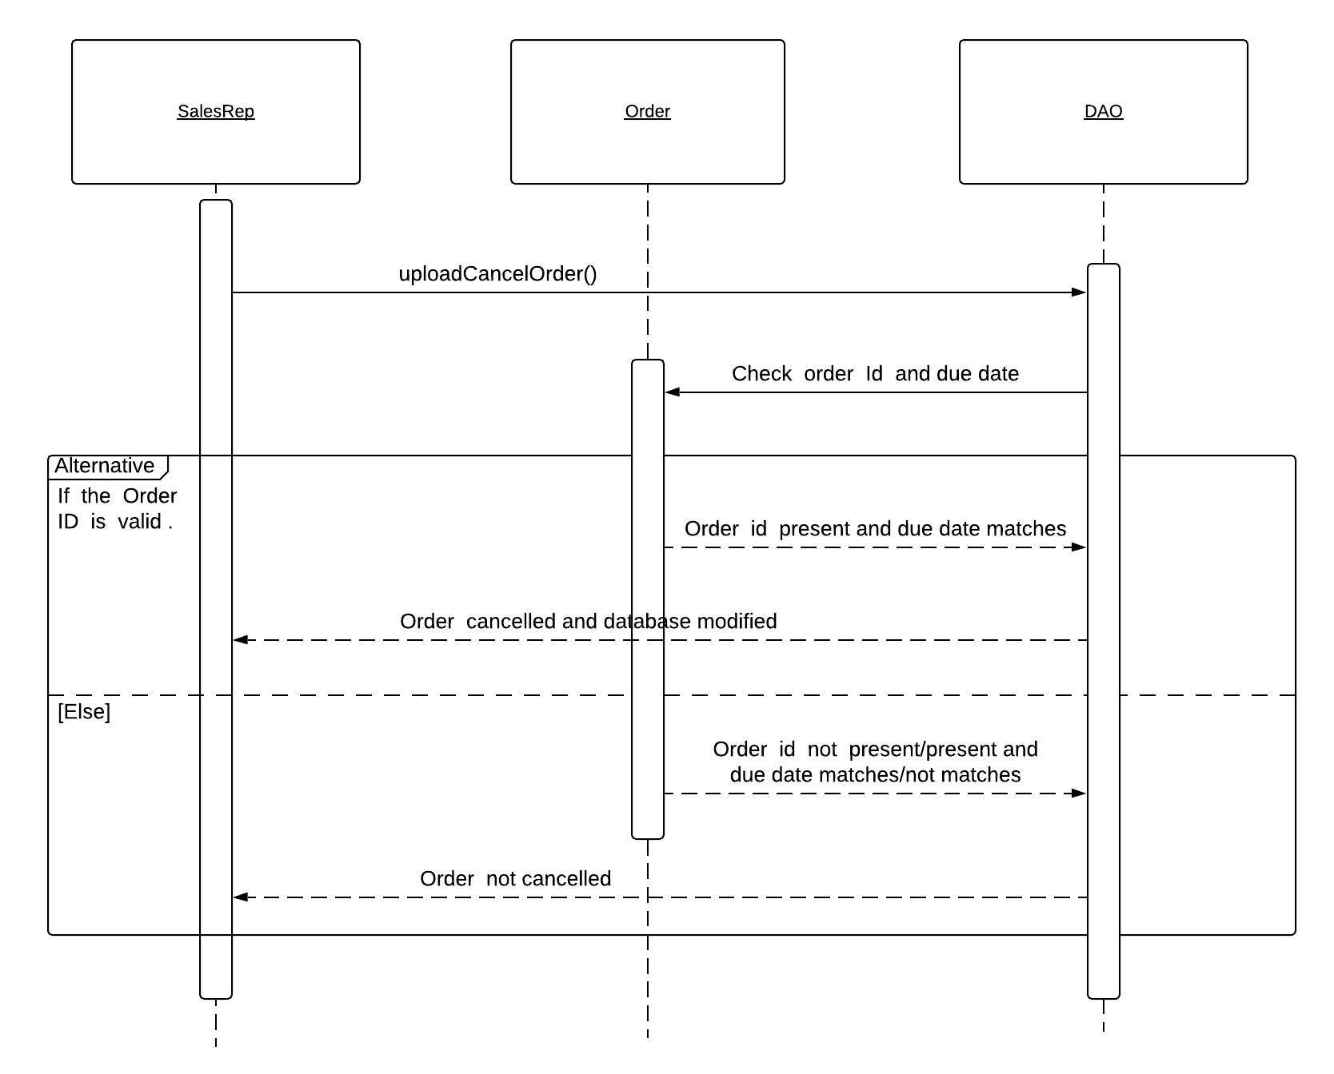
Sequence diagram for uploading Cancelled Order

Slide 29
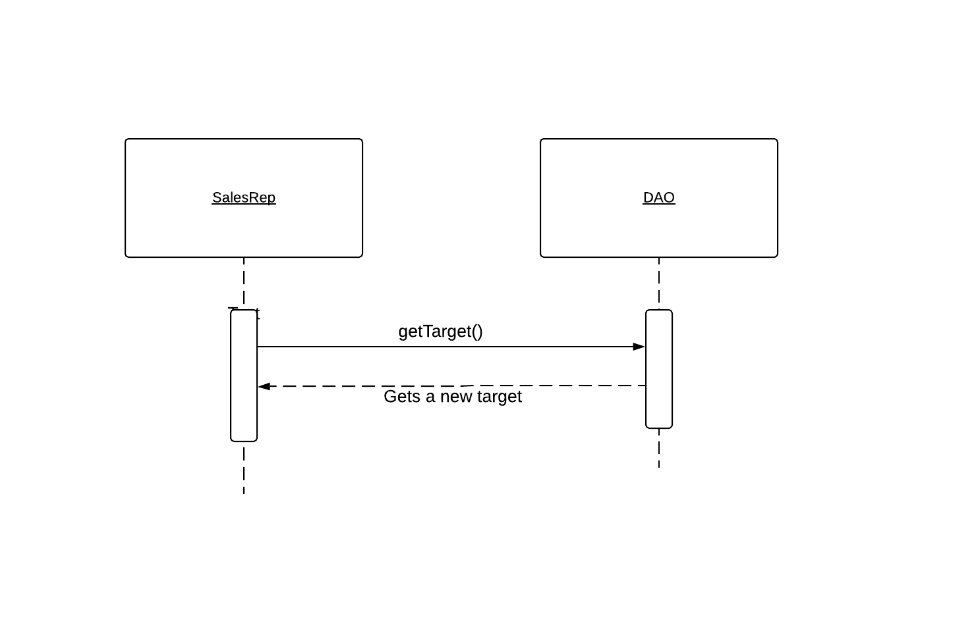
Sequence diagram for Getting sales target by Sales representatives

Slide 30
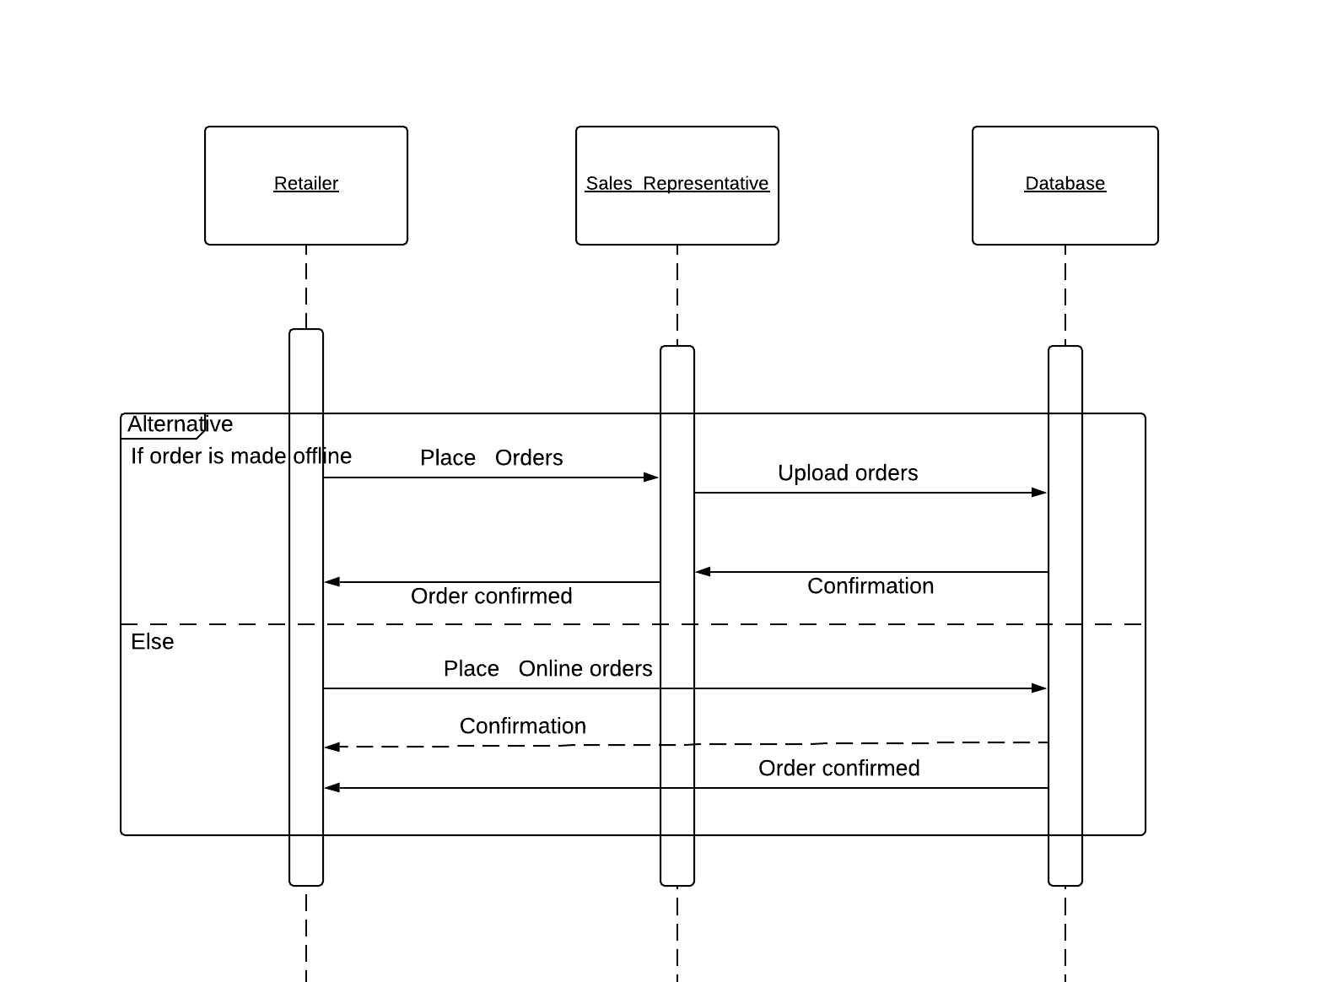
Sequence Diagram for Placing online and offline orders

Slide 31
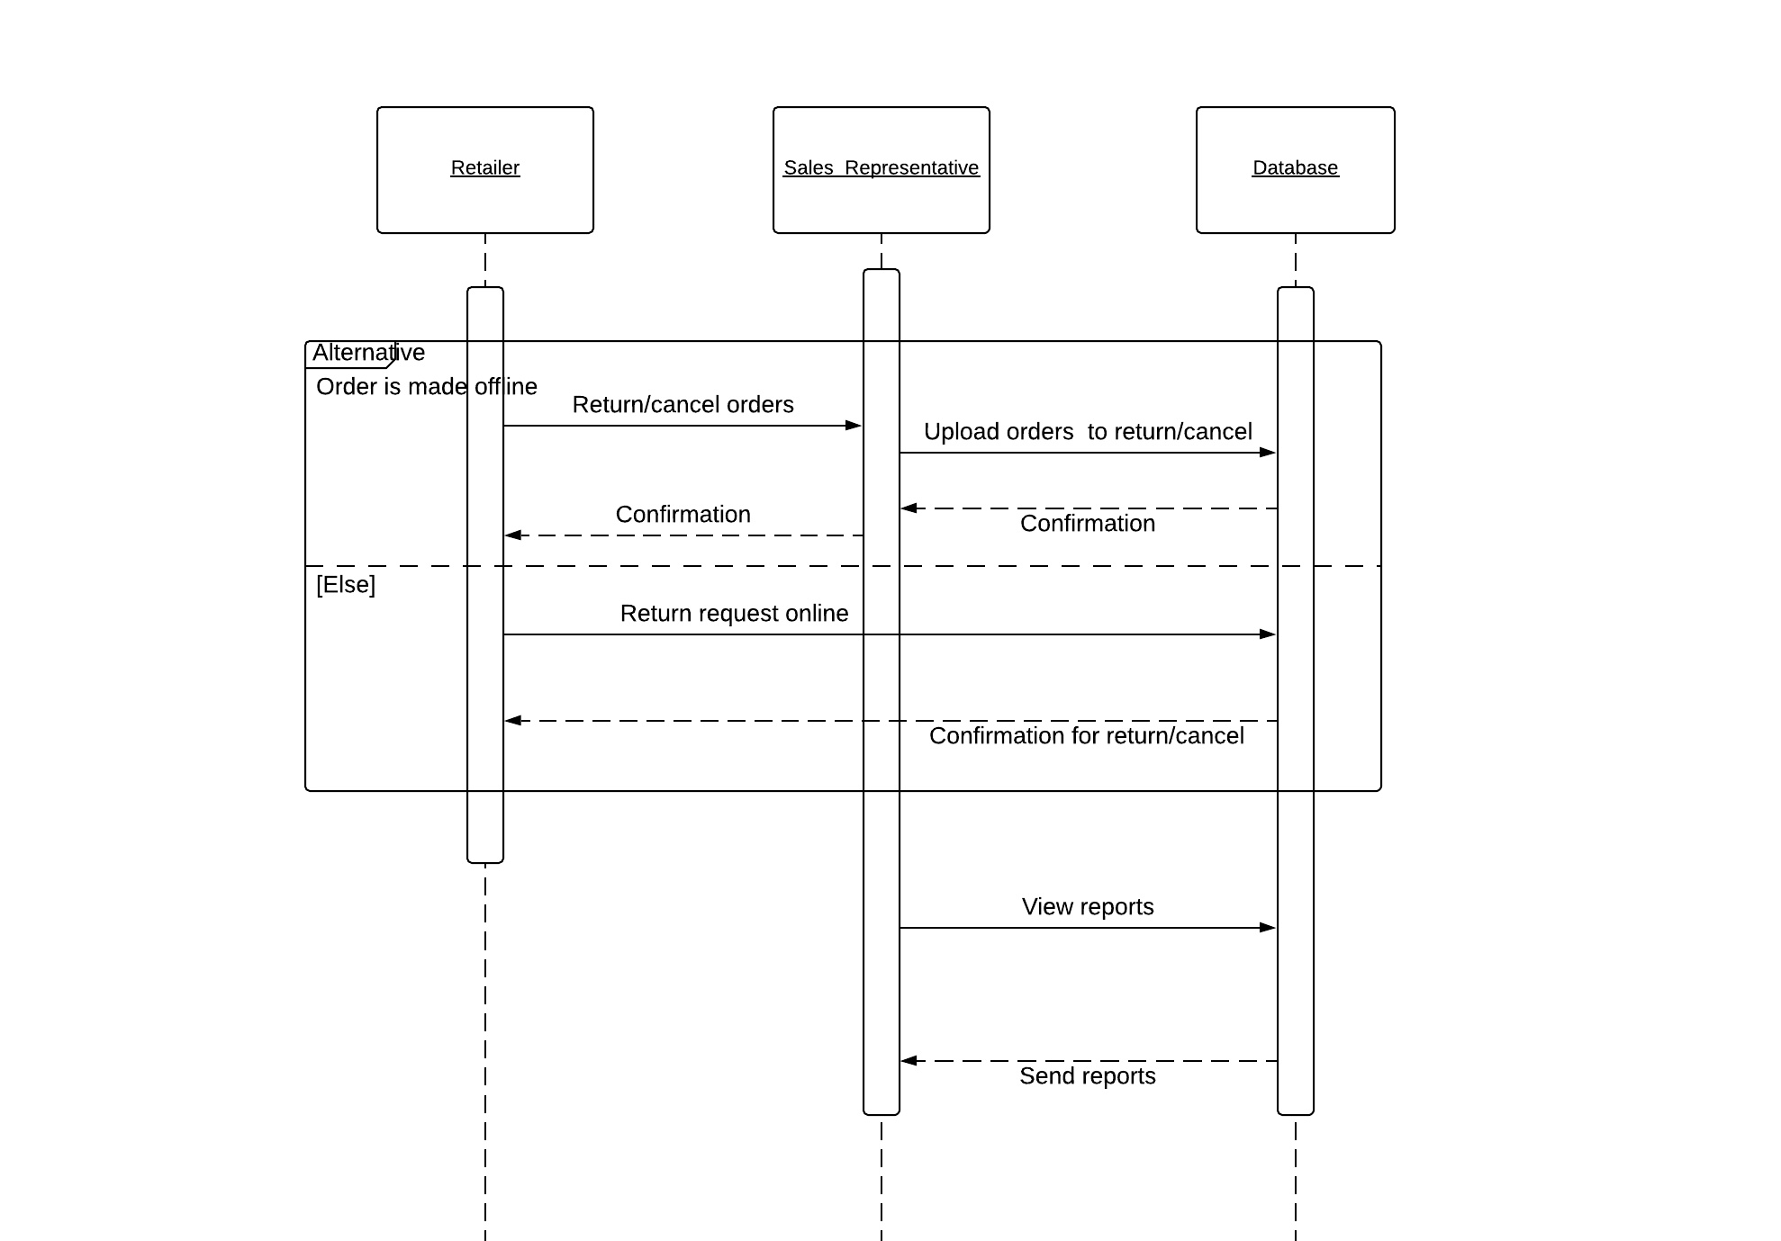
Sequence Diagram for returning online and offline orders and viewing reports

Slide 32
Sequence Diagram Of GO Admin

Slide 33
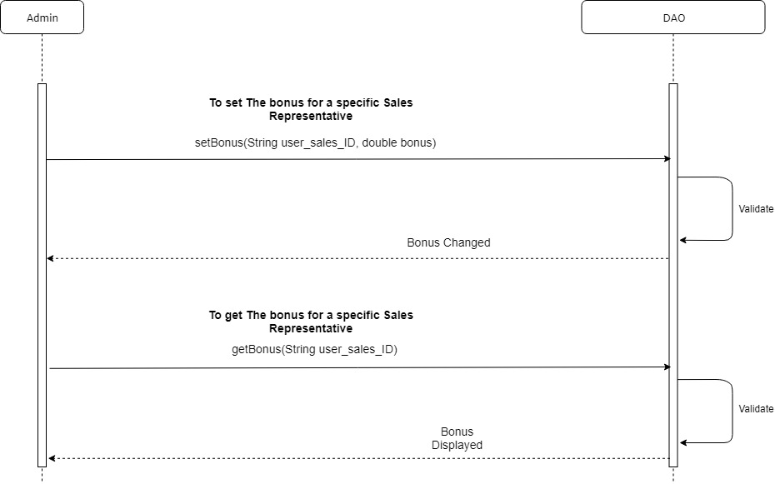

Slide 34
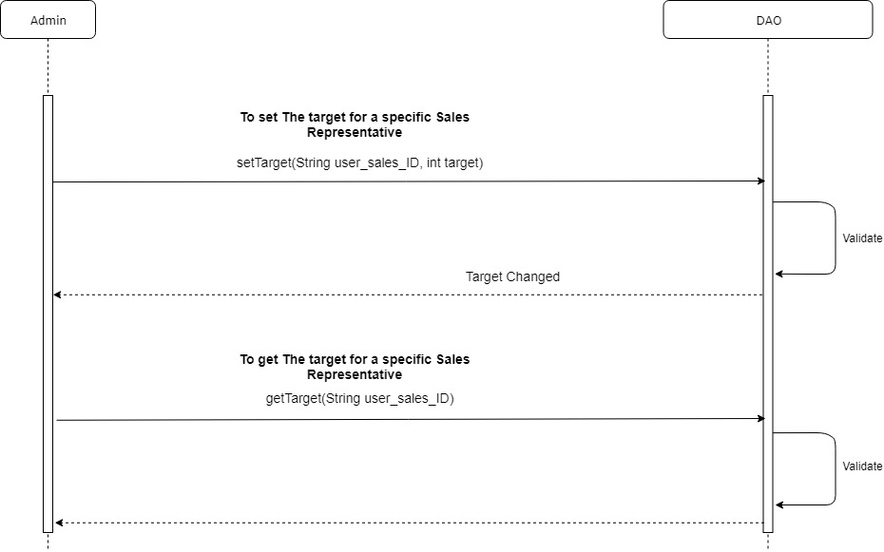

Slide 35
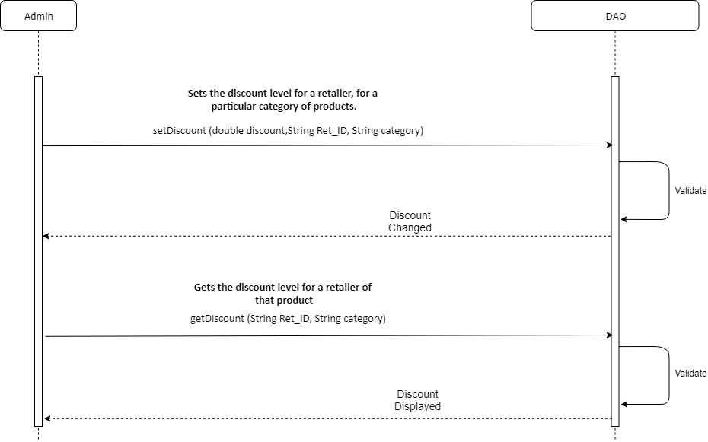

Slide 36
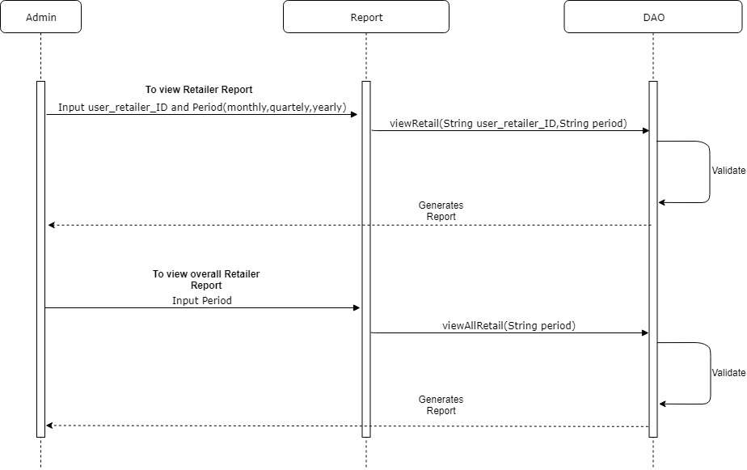

Slide 37


Slide 38
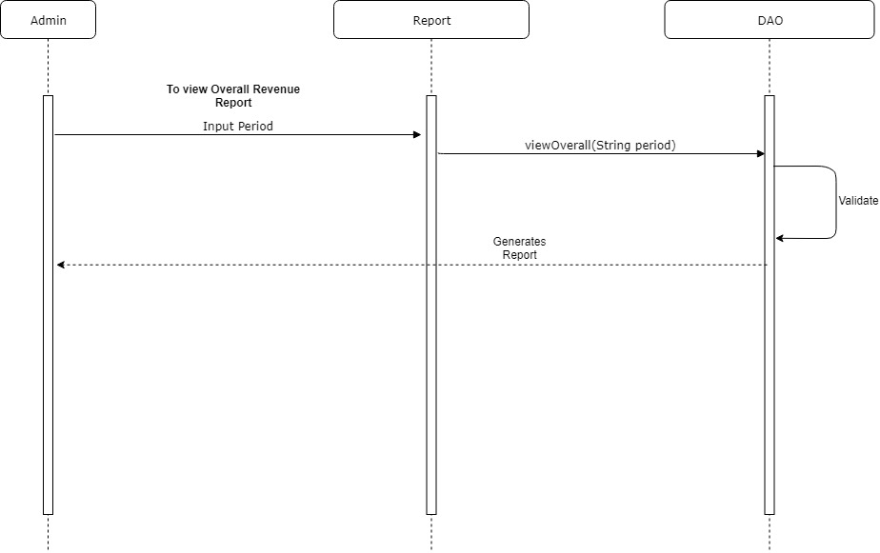

Slide 39
Team 2

Slide 40
FUNCTIONAL REQUIREMNETS
Order Management
Change Revenue Mix
Return Management
Retail Store Inventory

Slide 41

RETURN MANAGEMENT

Slide 42
Return Management Requirement Analysis
Business Strategies to provide reduction in Return.
Reduce Returns by targeting the categories that is in the direct control of GO Operations like Incomplete Product, Wrong Product Shipped (Ref 2.2.3, Pg 7)
To resolve the ambiguity due to inadequate product specification details while ordering. (Ref 2.2.3.1, Pg 7)
To have option to select delivery address while ordering ( To resolve ambiguity due to default shipping address was selected to deliver the products to the customers) (Ref 2.2.3.2, Pg 7)

Slide 43
Functional Requirement for Return Management System
Provide month on month /quarter or quarter /year on year reports on the reduction in Returns for both the reasons (Ref 2.2.3, Pg 8)
Provide alerts in cases when the wrong product is shipped (Ref 2.2.3, Pg 8)
Build Product Master (Ref 2.2.3.A, Pg 8)
Manage Product Shipping Addresses (Ref 2.2.3.B, Pg 8)
Maintain Customer Addresses List (Ref 2.2.3.C, Pg 8)

Slide 44
DATA FLOW DIAGRAM
Retailer/ Customer
Register/Login
Order a Product
Initiate a Return Request
Add Suggestions
Opt for Gift
Register/Login
Insert or Update a Product Details
Product Master
GO ADMIN
RETURN MANAGEMENT SYSTEM
Register/ogin
Retrieve the ad hoc report
Retrieve Canned report
Give Permission to Return Request
Update about Business or Return Policy

Slide 45
Use Case Diagram

Slide 46

Customer/Retailer Login
Product Master
Explore/ Search
Product
Insert /Update
Retailer Login/ Register
Admin Login
Initiate order
GO Admin
Order
Extended
Retrieve Purchase Hist
Add/
Change
Address
Address
Purchase History
Give Permission
New Customer/Retailer Login
Return /Cancel
Return
Report

Slide 47
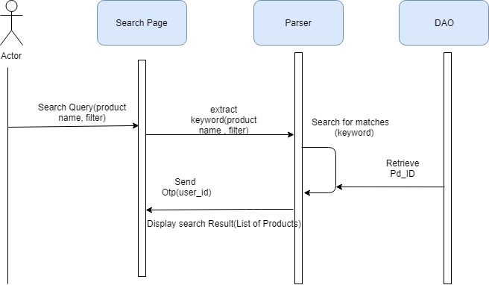
Sequence Diagram for Product Search
Product

Slide 48
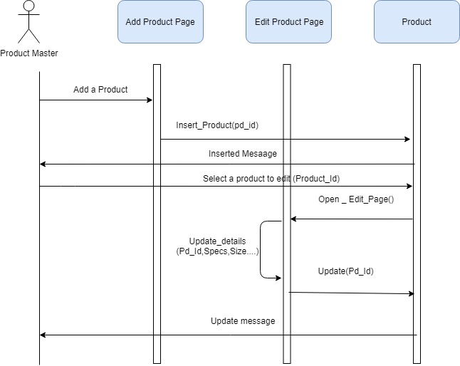
Sequence Diagram for Product Master

Slide 49
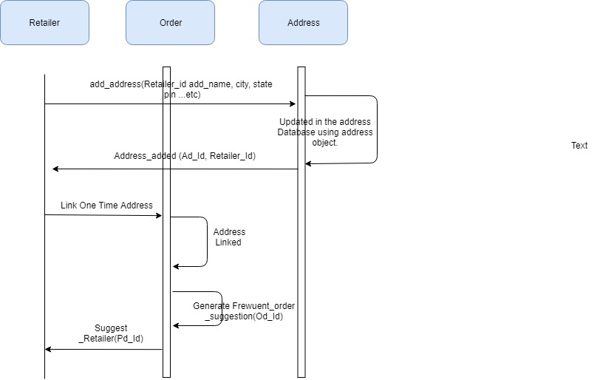
Sequence Diagram for Maintaining Addresses List

Slide 50
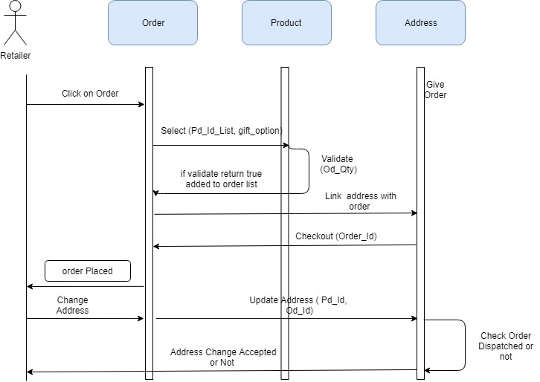
Sequence Diagram for Order and Changing Address
Order dispatched or not (order_id)

Slide 51
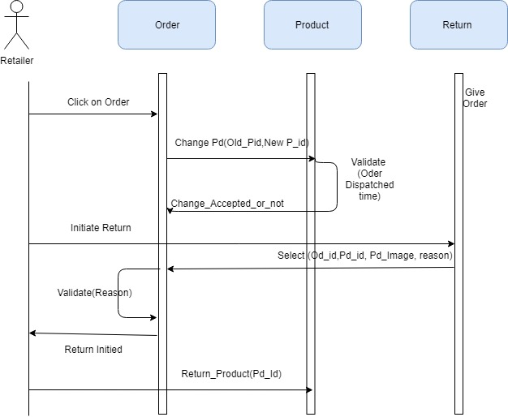
Sequence Diagram for Return
Validate (order processed or not)

Slide 52
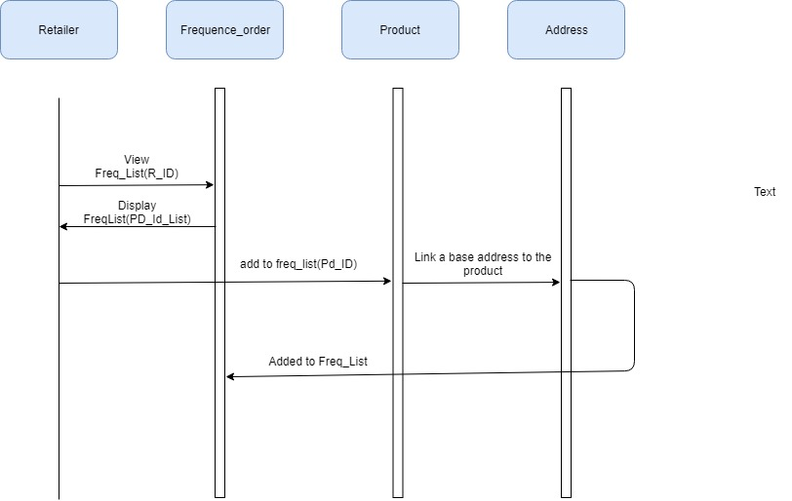
Sequence Diagram for Maintaining Frequently Order Product List

Slide 53
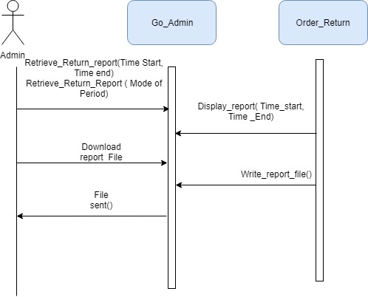
Sequence Diagram for Return Report

Slide 54
NON FUNCTIONAL REQUIREMENTS
All canned reports should be published in < 10 seconds
All ad hoc reports should be published in < 5 seconds
Product Master screen should not take more than 2 sec to create a product
Customer Order screen should be able complete submission of customer order within 3 sec including all validations on shipping address.
Customer Address List screen should not take more than 2 sec

Slide 55
Retail Store Inventory

Slide 56
Retail Store Inventory
Functional Requirements:
1.Reduce the inventory at Retail stores
Provide month on month /quarter or quarter /year on year reports on the time that an item stays on the shelf of the Retailer
Report the change
2.Track the time taken for the items to reach the Retailer from the warehouses of GO
Find out the outliers – (the ones that take the least and maximum time)
At Product category level.
At item level within the Outlier Product category.
At item level, irrespective of the Outlier Product category.

Slide 57
Functional Requirements
Function 1: Provide reports in monthly/quarterly/yearly basis on
(ref 2.2.4 Pg 9)
Product Shelf Time
Any changes that take place for a product in the shelf time
Function 2: Track the time taken for movement of goods from GO warehouse to retailer.
(ref 2.2.4 Pg 9)
Also find outlier product categories w.r.t the time taken (maximum and minimum)
Also find outlier items within the product category w.r.t the time taken (maximum and minimum)
Also find outlier items w.r.t the time taken (maximum and minimum)

Slide 58
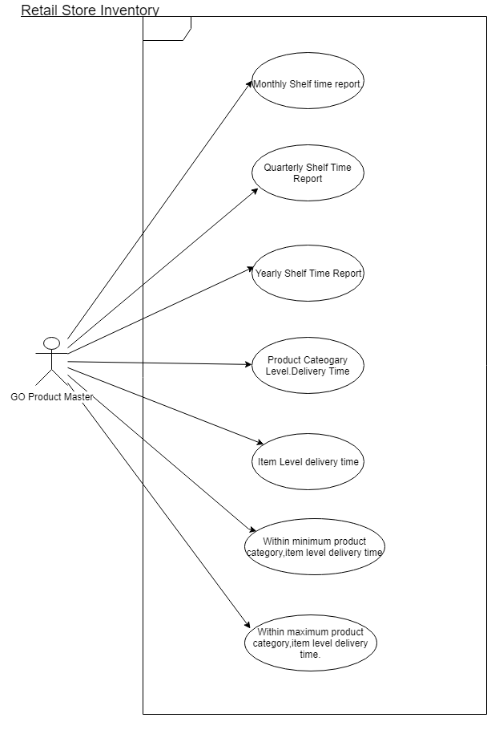
Use Case Diagram

Slide 59
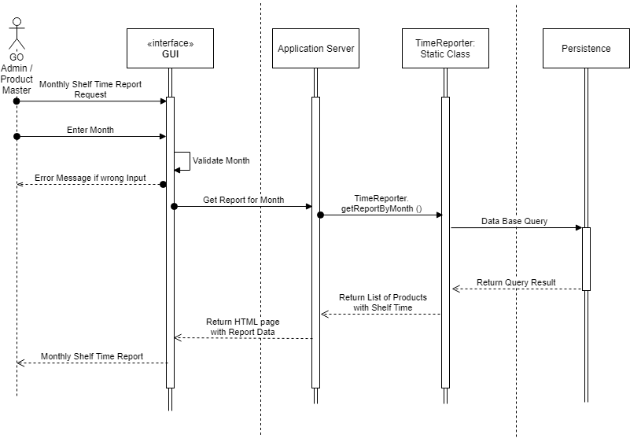
Sequence Diagram for Monthly Shelf Time Report

Slide 60
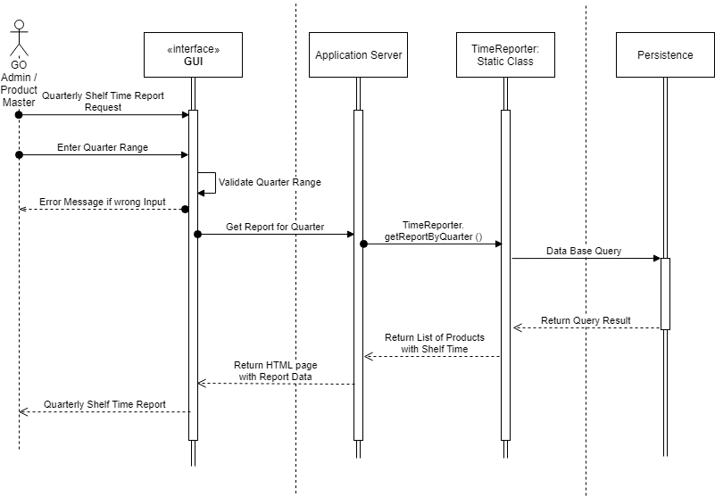
Sequence Diagram for Quarterly Shelf Time Report

Slide 61
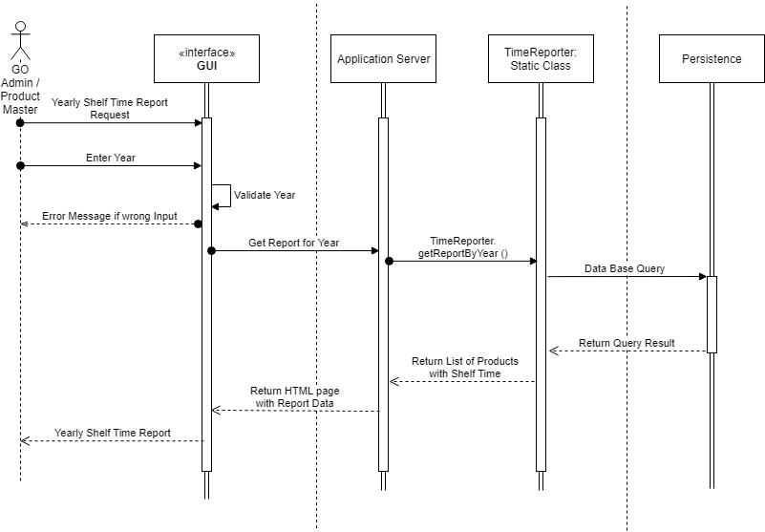
Sequence Diagram for Yearly Shelf Time Report

Slide 62
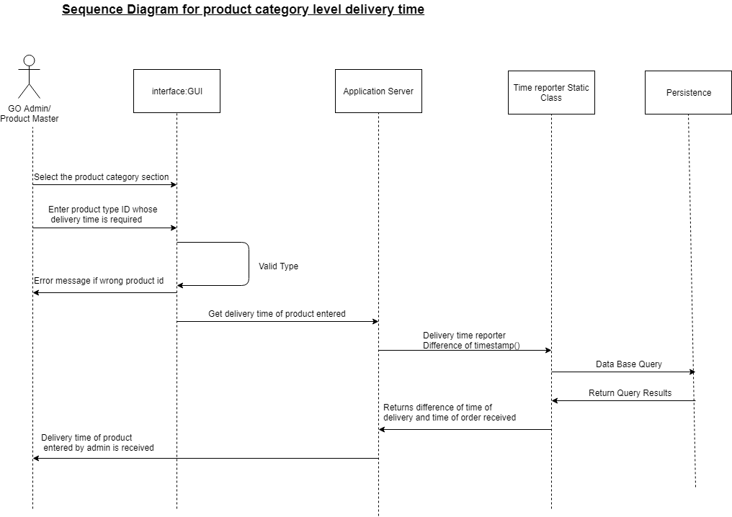
Sequence Diagram for Product Level Delivery Time Report

Slide 63
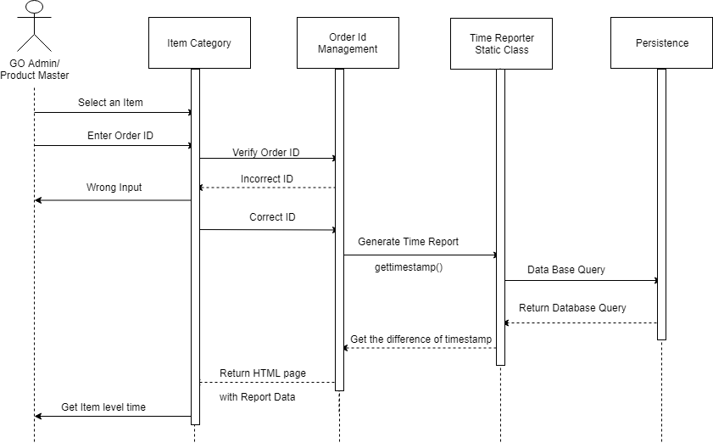
Sequence Diagram for Item Level Delivery Time Report

Slide 64
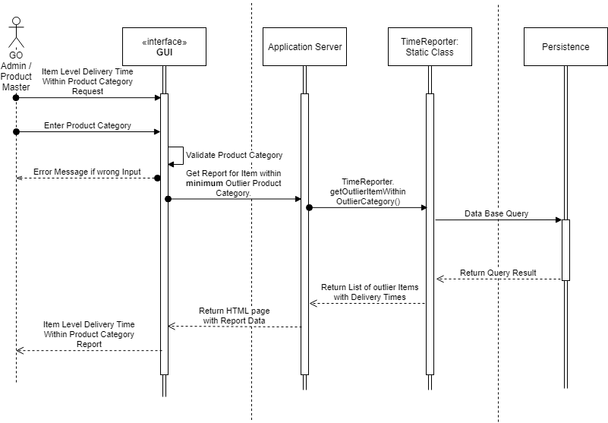
Sequence Diagram for Item Level in outlier Product Category Minimum Delivery Time Report

Slide 65

Sequence Diagram for Item Level in outlier Product Category Maximum Delivery Time Report

Slide 66
ER Diagram

Slide 68


